Slide 1

DIGITAL PRESENCE | SOCIAL MEDIA | BRAND VISIBILITY
Social Media & Digital
Marketing Proposal
Google Business Profile & Social Media Management
Prepared by: Lentera Technologies Private Limited
Date: [DATE]
Prepared exclusively for client review and confirmation

Slide 2
WHAT'S INCLUDED
Scope of Work
Google Business Profile Registration
Creation and setup of Google Business Profile with business information, category, contact details, location and supporting information.
Social Media Account Registration
Registration / setup of up to [X] social media platforms based on the client's business requirements.
Social Media Content Creation
Management of up to [X] social media platforms, including the creation of [X] professional posts per month aligned with the client's brand and business objectives.
Social Media Publishing Support
Scheduling / publishing of approved posts across the selected social media platforms.
Basic Digital Presence Management
Maintaining consistent branding, business information and content presentation across the selected digital channels.
Lentera Technologies Private Limited
Scope of Work

Slide 3
WHERE WE'LL SHOW UP
Proposed Social Media Platforms
Up to 6 platforms, selected based on the client's target audience and business requirements. Final platforms will be confirmed during project initiation.
f
ig
in
yt
X
p
Facebook
Instagram
LinkedIn
YouTube
X / Twitter
Pinterest*
* Or other platform relevant to the client's audience
Lentera Technologies Private Limited
Proposed Social Media Platforms

Slide 4
HOW WE'LL WORK TOGETHER
Engagement Model
We propose a monthly digital marketing support model focused on establishing and maintaining a consistent online presence.
Activity | Frequency
Google Business Profile Registration | One Time
Social Media Account Registration | Up to [X] Platforms – One Time
Social Media Creative Posts | [X] Posts / Month
Content Planning | Monthly
Post Design & Formatting | [X] Posts / Month
Publishing / Scheduling Support | Monthly
Basic Digital Presence Review | Monthly
Monthly Digital
Marketing
Engagement
A steady, predictable cadence of content and publishing support — designed to build consistent brand presence month over month.
Lentera Technologies Private Limited
Engagement Model

Slide 5
CONTENT, EVERY MONTH
Monthly Deliverables
THE POSTS MAY INCLUDE
Product / Service Highlights
Industry-related Content
[X]
Company Updates
Festive / Occasion-based Content
Social Media Posts
Per Month
Promotional Content
Brand Awareness Content
Educational / Informative Content
LinkedIn Organic Page Follower Growth
Content will be prepared based on the client's business information, available materials and approved monthly content direction.
LinkedIn Page Visibility & Reach Enhancement
Content Optimization for Better Organic Engagement
Lentera Technologies Private Limited
Monthly Deliverables

Slide 6
PROCESS
Digital Marketing Workflow
Monthly Content & Publishing Workflow
1
›
2
›
3
›
4
›
5
›
6
›
7
›
8
Business Information /
Requirements
Monthly Content
Planning
Content & Creative
Development
Client Review &
Approval
Revisions,
if required
Final
Approval
Publishing /
Scheduling
Monthly Content
Completion
Lentera Technologies Private Limited
Digital Marketing Workflow

Slide 7
CONSISTENT & ON-BRAND
Social Media Content We Deliver
Our social media creatives will be designed to maintain a professional and consistent digital presence.
CONTENT CATEGORIES
CREATIVE APPROACH
Brand Awareness
Brand-aligned visual design
Product & Service Promotion
Company Updates
Consistent typography and colours
Customer Engagement
Platform-appropriate dimensions
Industry Insights
Promotional Campaigns
Clear messaging and call-to-action
Events & Announcements
Professional and engaging layouts
Festival / Occasion Posts
Lentera Technologies Private Limited
Social Media Content

Slide 8
PORTFOLIO
Sample Creative Work
A glimpse of the creative range and design quality our team delivers

Slide 9
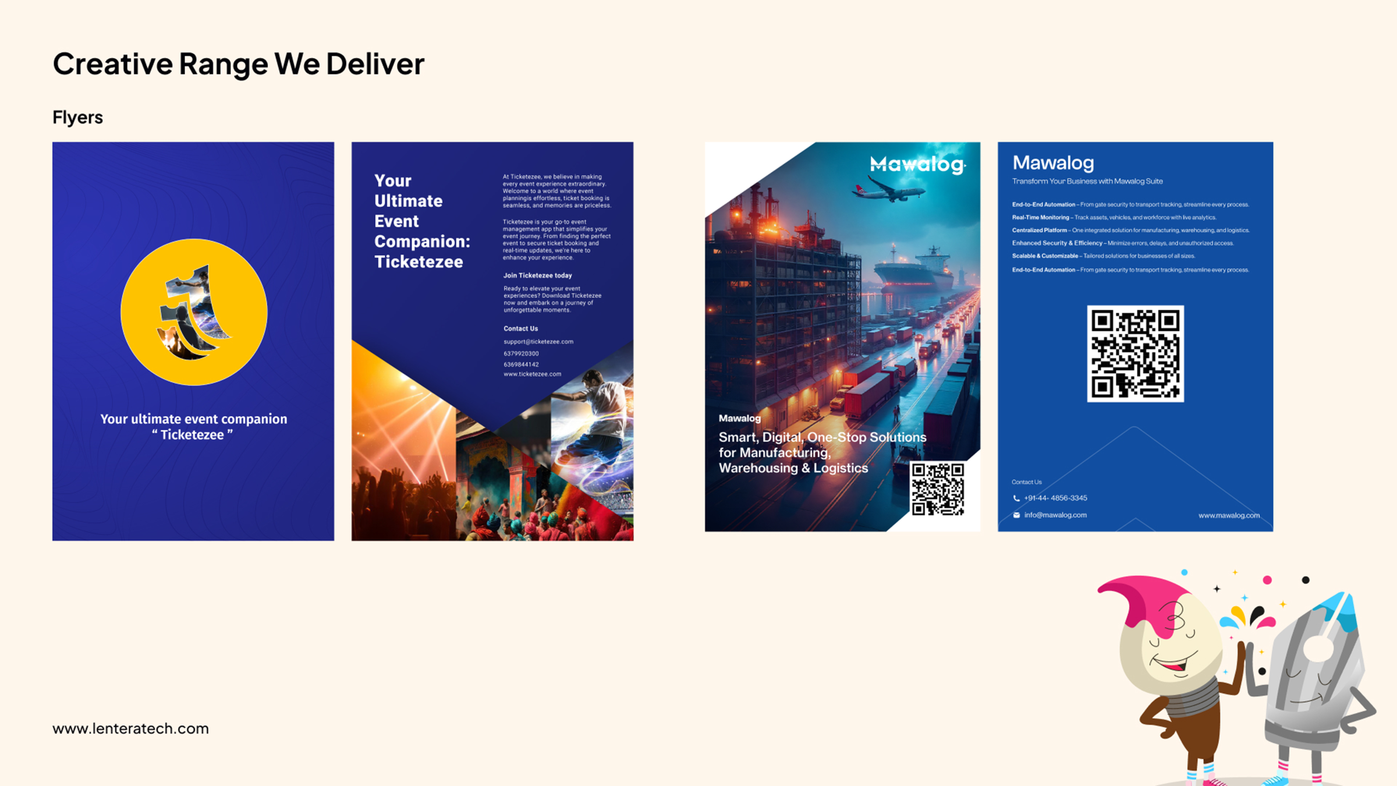

Slide 10
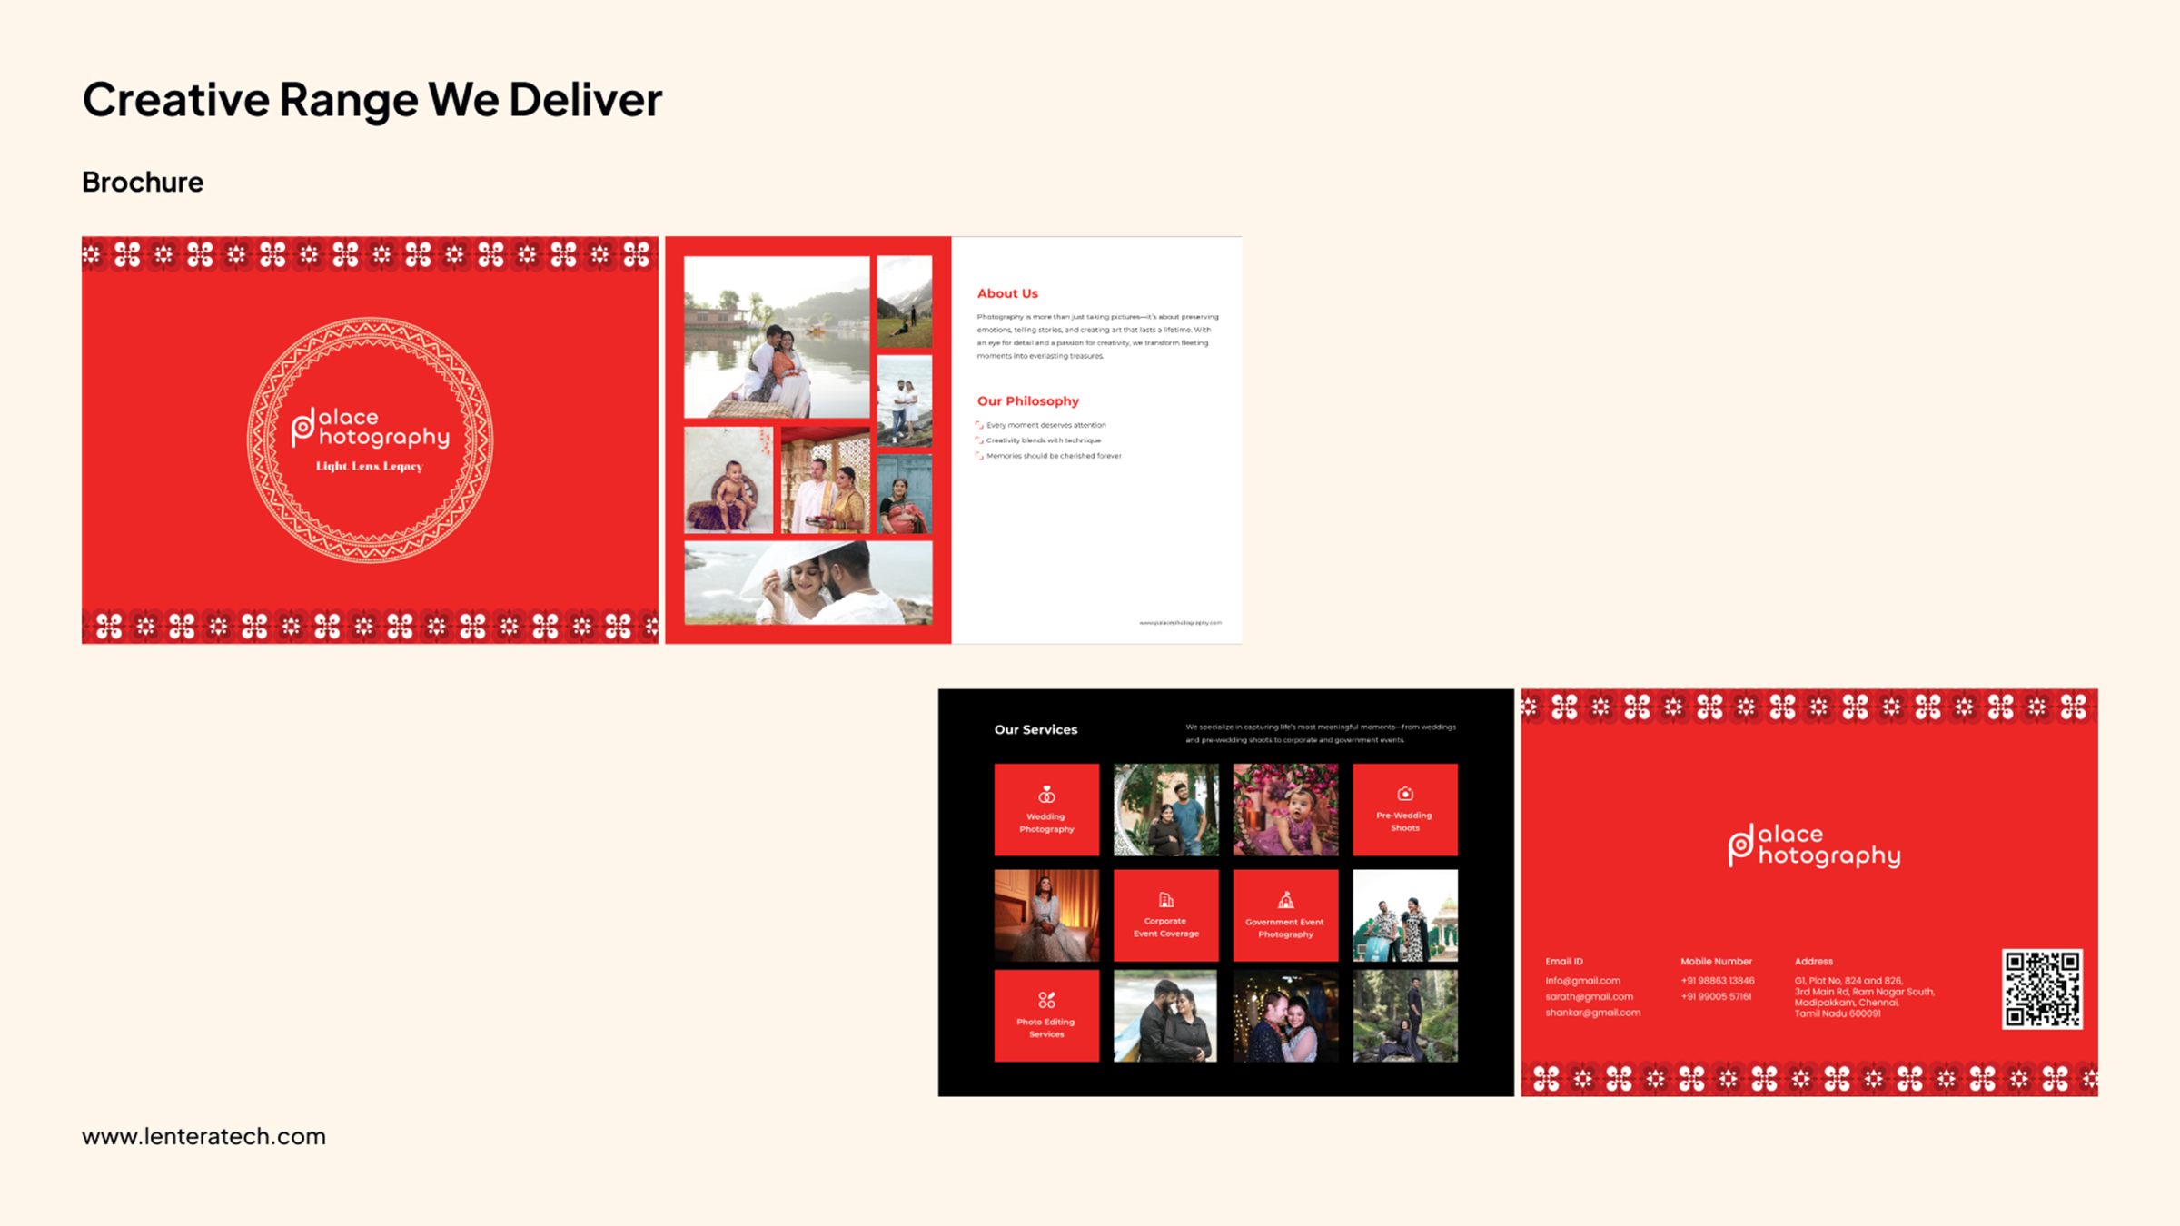

Slide 11
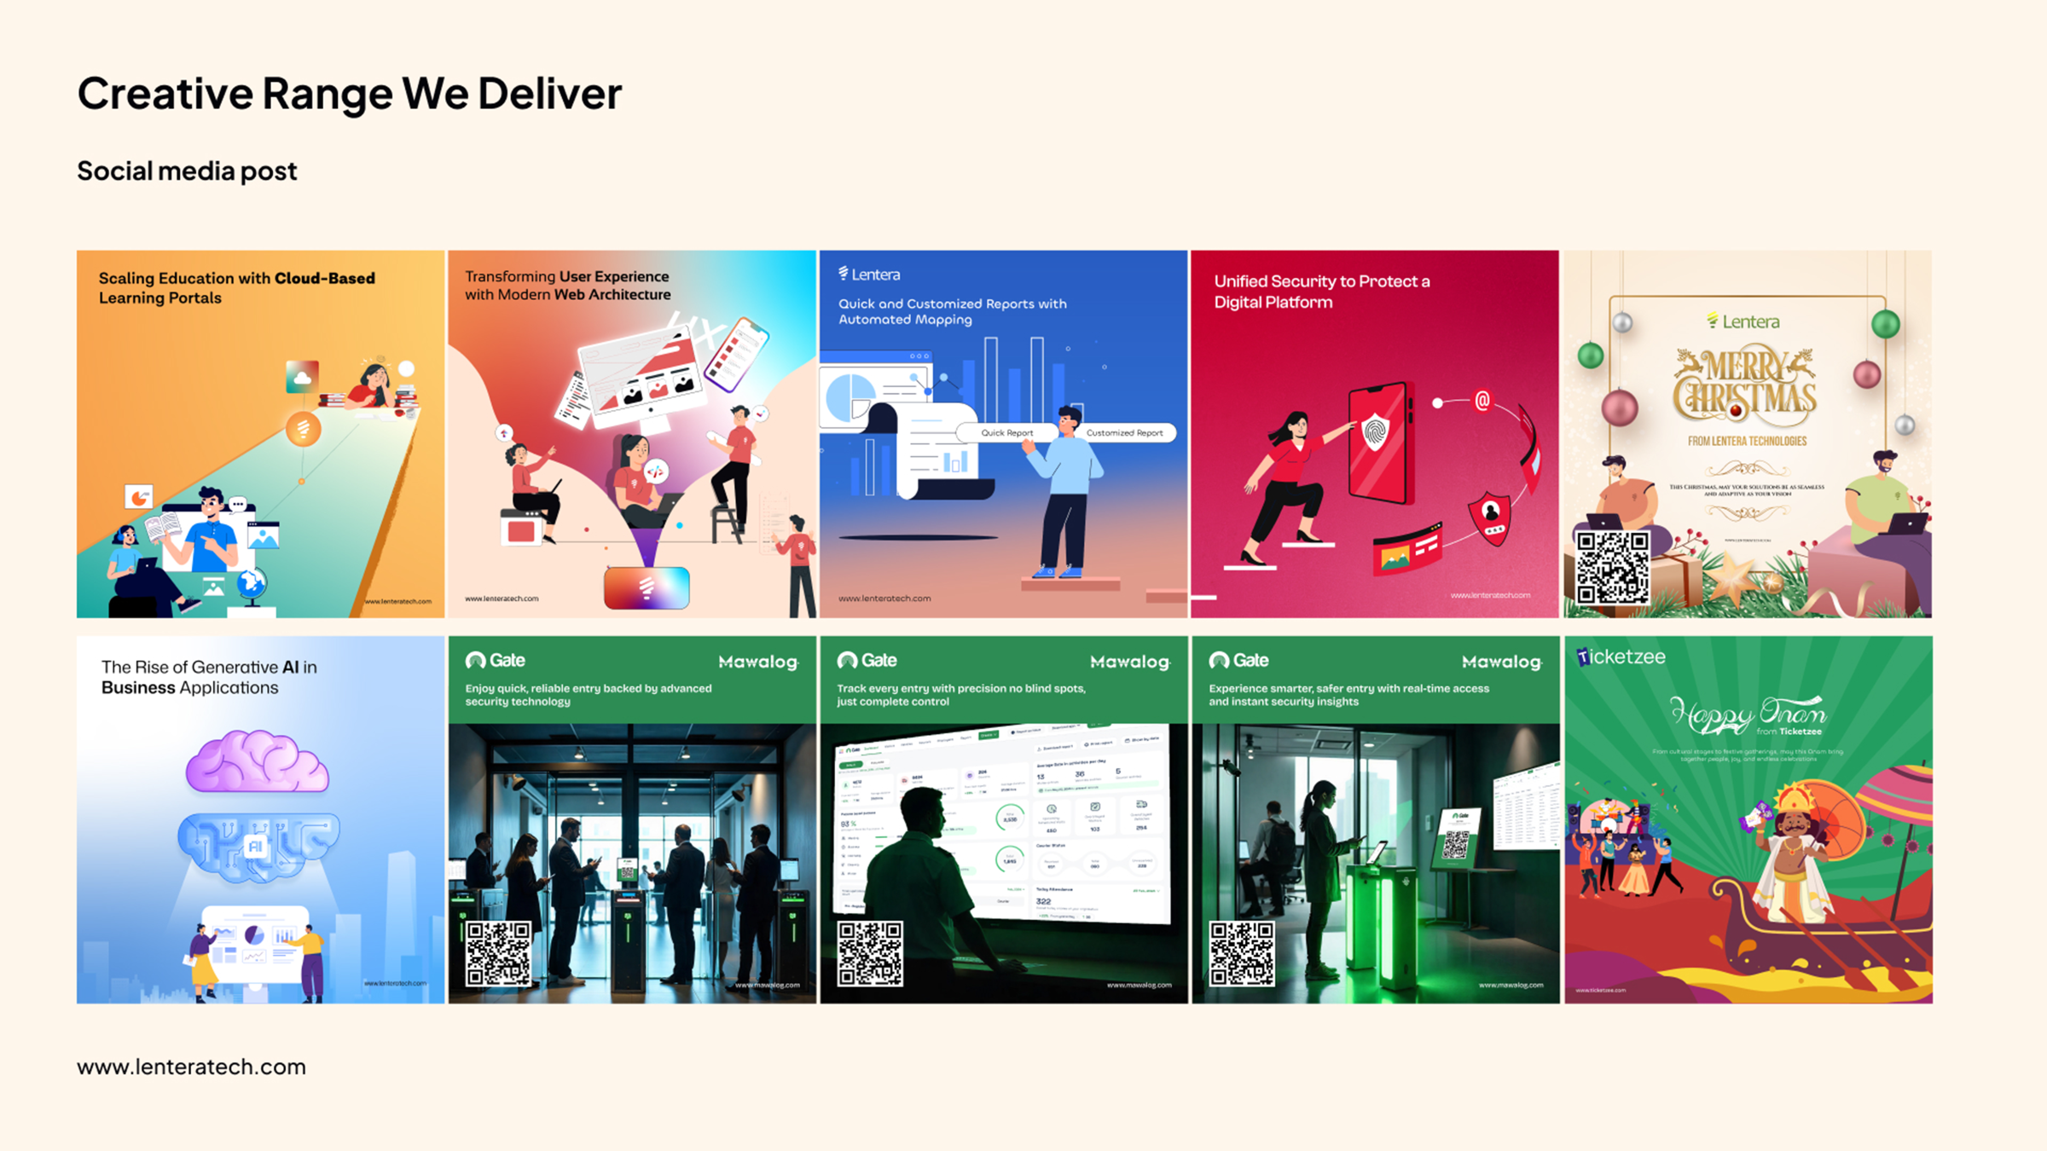

Slide 12
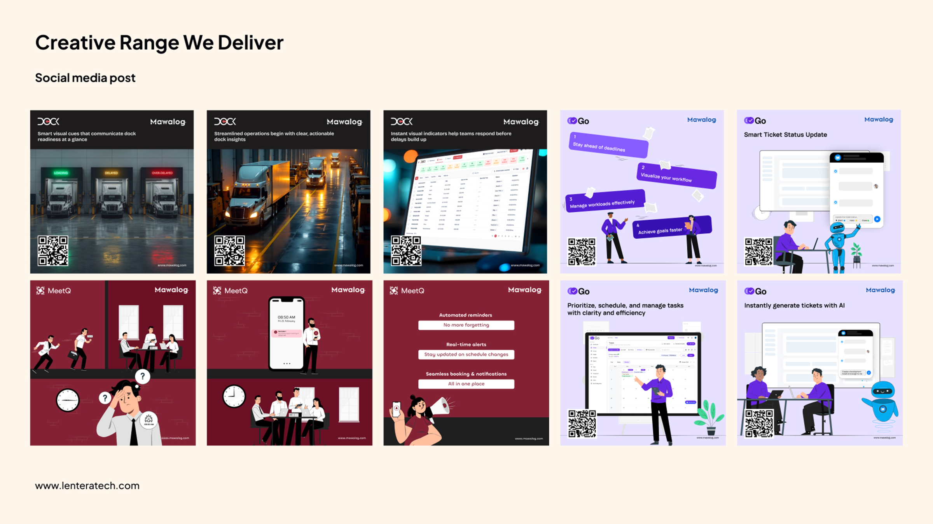

Slide 13
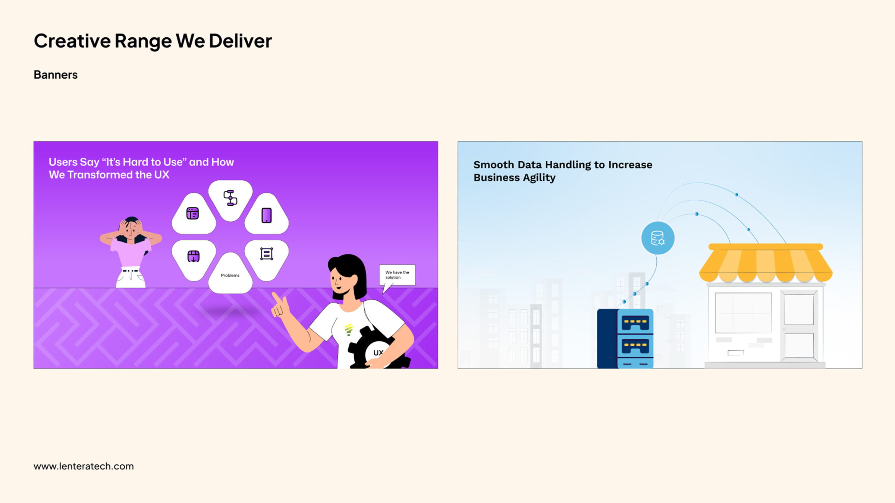

Slide 14
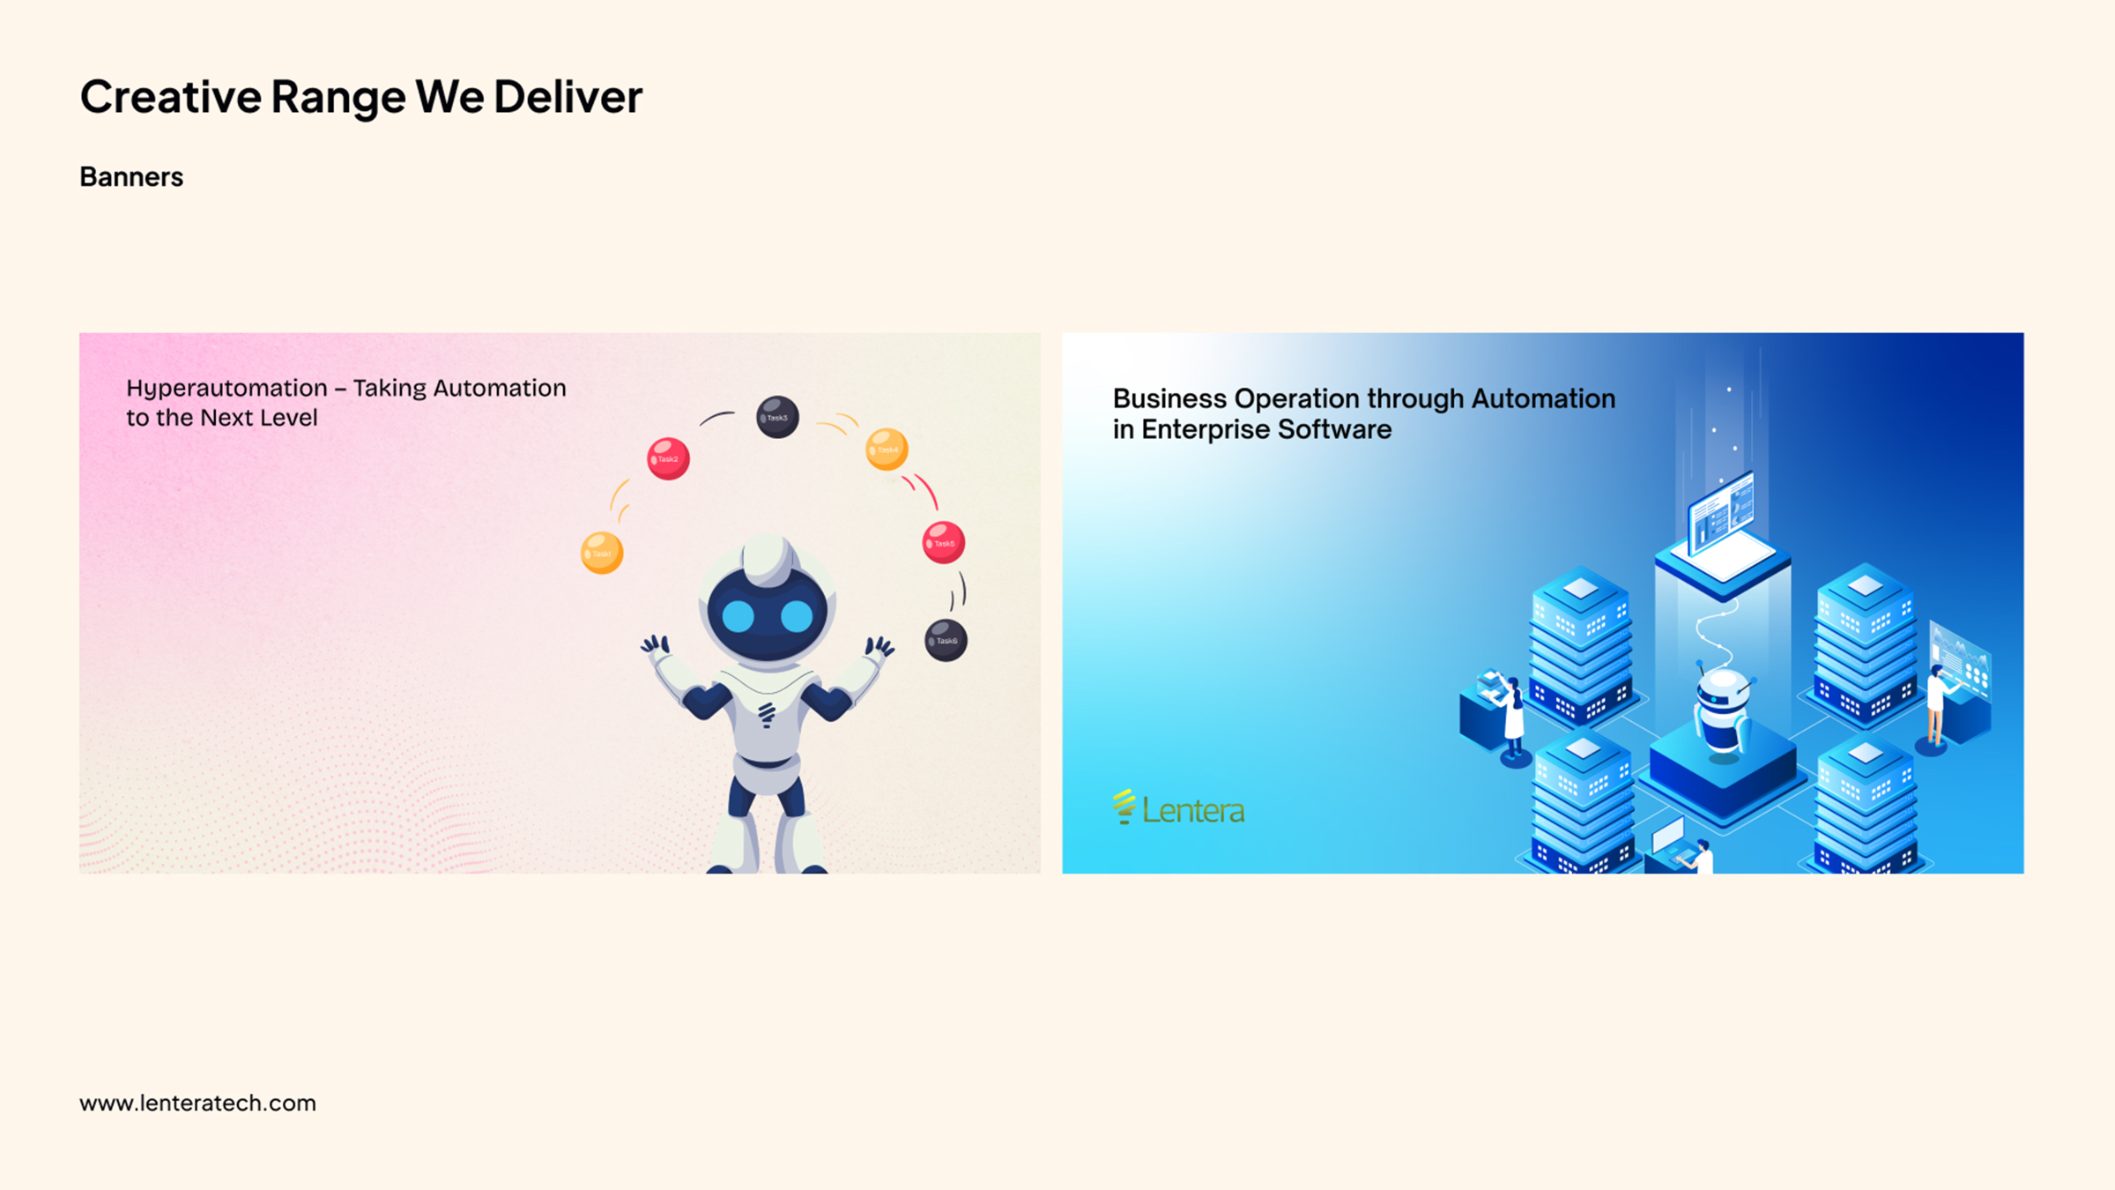

Slide 15
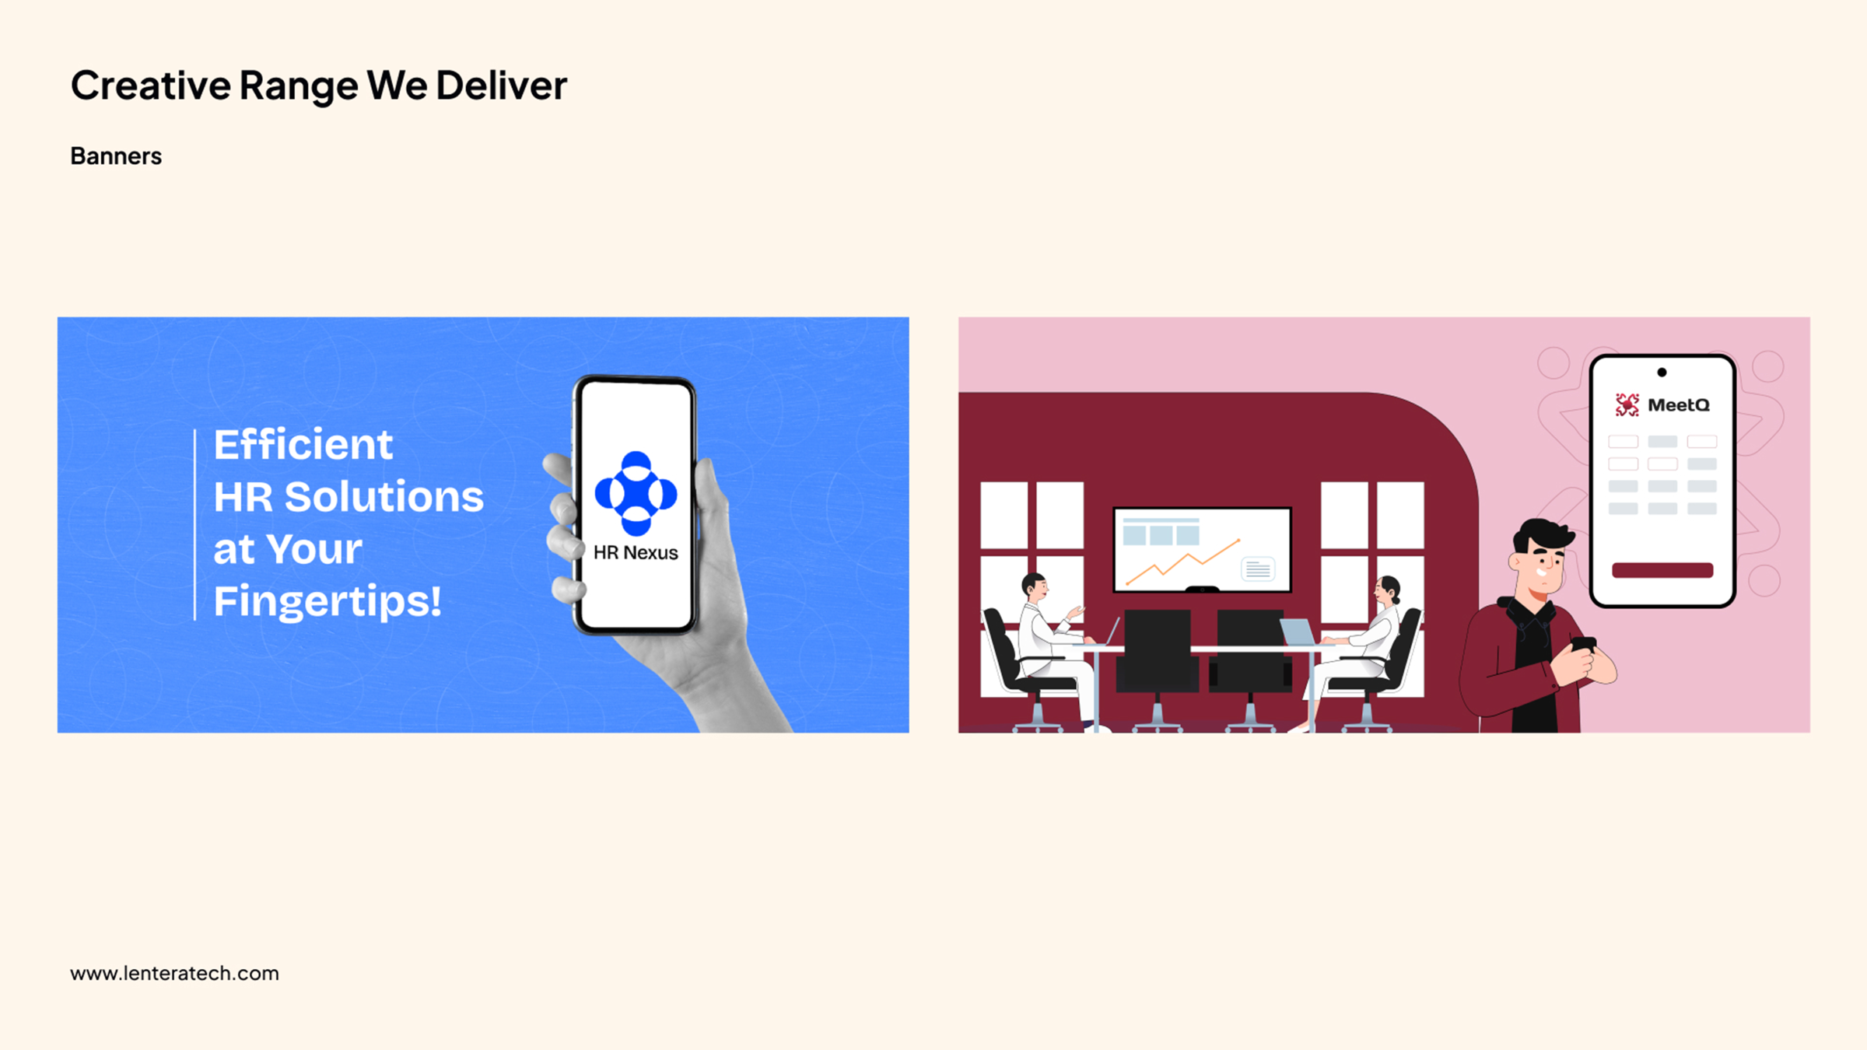

Slide 16
LOCAL VISIBILITY
Google Business Profile Setup
We will support the client in establishing their business presence on Google.
SCOPE
IMPORTANT NOTE
Google Business Profile registration
Website information
Google's verification process and approval are controlled by Google. Any verification method, documentation or additional requirements requested by Google will need to be fulfilled by the client.
Business name and category setup
Business hours
Business description
Logo and cover image setup
Address / service area configuration
Basic business information optimization
Contact information
Verification support
Lentera Technologies Private Limited
Google Business Profile

Slide 17
INVESTMENT
Commercial Proposal
Service | Type | Cost
Google Business Profile Registration & Setup / [X] Social Media Account Registration / Setup | One Time | ₹X,XXX
Digital Marketing – [X] Social Media Posts / Month | Monthly | ₹X,XXX / Month
Additional Charges |  | ₹XXX / Post
All prices are exclusive of applicable GST. Detailed commercial breakdown follows on the next slide.
Lentera Technologies Private Limited
Commercial Proposal

Slide 18
INVESTMENT
Commercial Summary
ONE-TIME SETUP
MONTHLY DIGITAL MARKETING
TOTAL FIRST MONTH
₹X,XXX + GST
₹X,XXX + GST / Month
₹XX,XXX + GST
Subsequent Months: ₹X,XXX + GST / Month
INCLUDED IN MONTHLY RETAINER
NOT INCLUDED
✓
[x] social media creatives
✕
Paid advertising / ad spend
✕
Influencer marketing
✓
Content planning
✕
Professional photography / videography
✓
Creative design
✕
Video production / reels
✓
Content formatting
✕
Website development
✓
Publishing / scheduling support
✕
SEO
✓
Basic digital presence management
✕
Paid third-party tools or subscriptions
✕
Premium stock images / assets, if required
Lentera Technologies Private Limited
Commercial Summary

Slide 19
PLEASE REVIEW
Terms & Conditions
1.
18% GST will be applicable as per prevailing regulations.
9.
Additional creatives or deliverables beyond the agreed monthly scope will be treated as additional work and quoted separately.
2.
Google Business Profile registration is subject to Google's verification and approval process.
10.
Paid advertising / media spend is not included in the above commercials.
3.
Social media account registration requires the client to provide necessary business information, credentials and verification details.
11.
Third-party subscription, premium stock image, video, music or other licensed assets, if required, will be charged separately.
4.
Monthly retainer includes [x] social media posts per calendar month.
12.
Monthly support / digital marketing services are billed as per the agreed monthly engagement.
5.
Unused monthly post deliverables cannot be carried forward to subsequent months.
13.
Payment is due within 10 days from the date of invoice.
6.
Content will be developed based on information, images and business inputs provided by the client.
14.
Services will be delivered according to the agreed schedule and monthly content plan.
7.
Client approval is required before publishing the content.
15.
Any additional requirements outside the defined scope will be treated as a Change Request and quoted separately.
8.
Reasonable revisions are included within the agreed scope.
Lentera Technologies Private Limited
Terms & Conditions

Slide 20
THANK YOU
We look forward to your
confirmation
Please review the scope and commercials above and confirm to proceed. We're happy to walk through any section on a call.
Lentera Technologies Private Limited

